Slide 1

Learning pathways – Autonomous learners – Assessment
Anne Ontero
Graz, January 2018
Notes:
The National Core Curricula for Secondary Schools were reformed in 2014 - 2015 and the local curricula based on the new national core curricula have come into effect on 1 August 2015 and 2016.

Slide 2

Exam papers not got back; feedback not received?
Girls ask for word tests ?
Asian students in the class behave differently: feedback asked

Slide 3
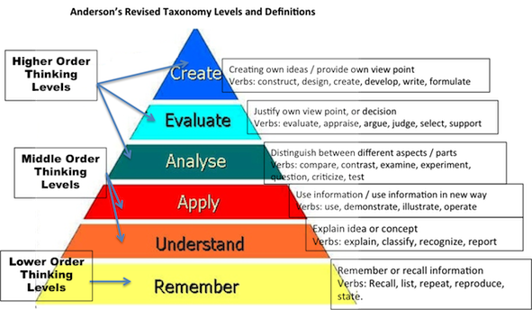
What is taught and what is tested ?
Notes:
From lower order thinking skills towards higher order thinking skills

Slide 4

4
of 20
Notes:
Participatory action research project: Affordances of the dialogical learning environment (integration of formal and informal and previous learning: learning path)

Slide 5

Dialogical Learning Environment
The more the student becomes the teacher and the more the teacher becomes the learner the more successful the achievement outcomes.
5
of 20
Notes:
- “The more the student becomes the teacher and the more the teacher becomes the learner” the more successful the achievement outcomes. (Hattie)
Dialogical approach requires support for learners’ autonomy, the ability to work independently and self-assessment skills.
To explore and analyze learning in the dialogical environment to finParticipatory action research project: Affordances of the dialogical learning environment (integration of formal and informal and previous learning: learning path)d its affordances for learning English

Slide 6
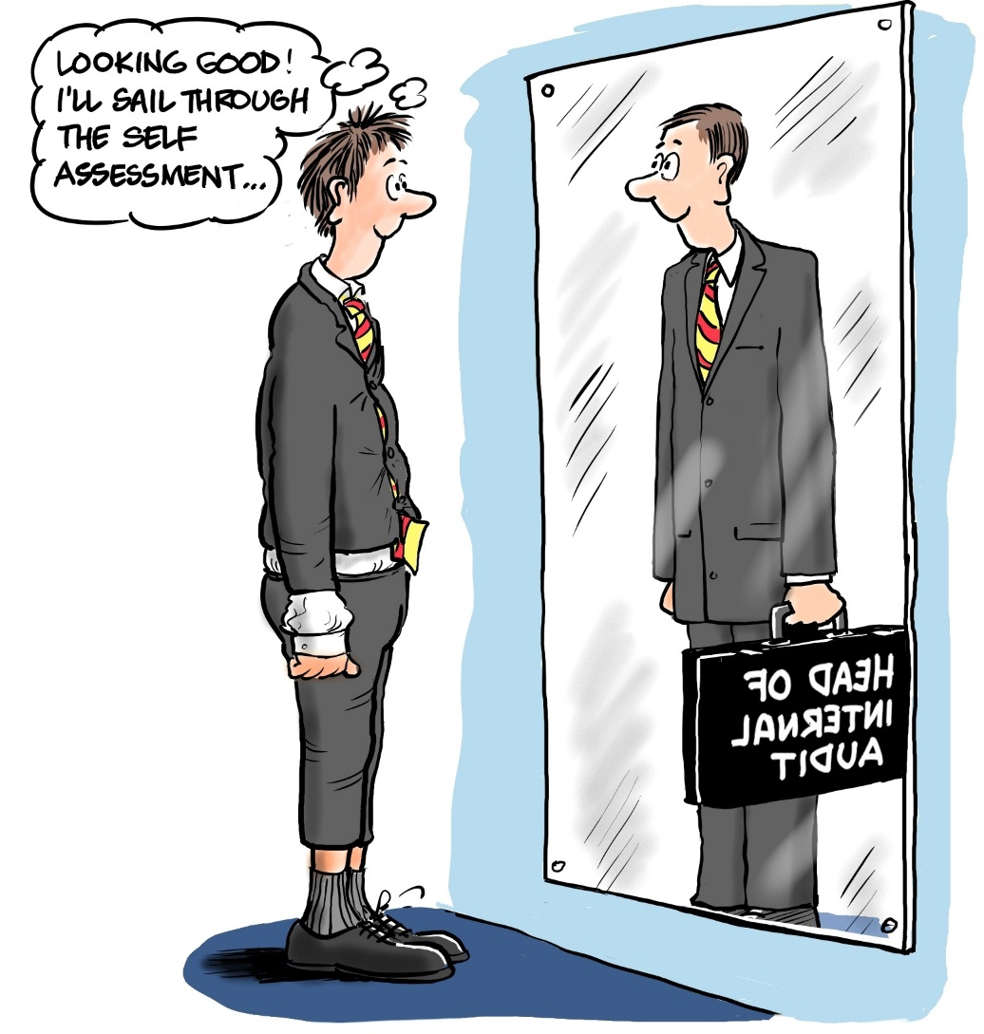
Self-assessment and learning

Slide 7
Assessment?
Diagnostic assessement
Formative assessment
Summative assessment
Prognostic assessment

Slide 8
Assumptions of what is happening in the classromm
”Teacher talk”
“There is little real dialogue between students and teachers”
“I am not as good as I thought I was”
Traditional, very formal classes were preferred when approaching the final exam
8
of 20

